Slide 1

Life In the Jamestown Colony:
Don’t Roll the Dice if You Can’t Pay the Price
Melanie Gouine, Margaret Koger, and Heather MacKenzie

Slide 2

Sparking Activity:
We are Taking a Voyage!

Slide 3
Roll for your Role:
Was success in the Jamestown Colony as Simple as a Role of the Dice?

Slide 4
Background Refresher
  England hoped to find silver and gold in America
The stockholders of the Virginia Company of London financed the settlement of Jamestown
The Susan Constant, Godspeed, and Discovery reached the Virginia coast in late April 1607 with 104 settlers on board
Jamestown became the first permanent English settlement in North America in 1607
The first two English women arrived at Jamestown in 1608
John Smith’s departure in 1609 was followed by the “starving time,” a period of warfare between the colonists and Indians and the deaths of many English men and women from starvation and disease

Slide 5
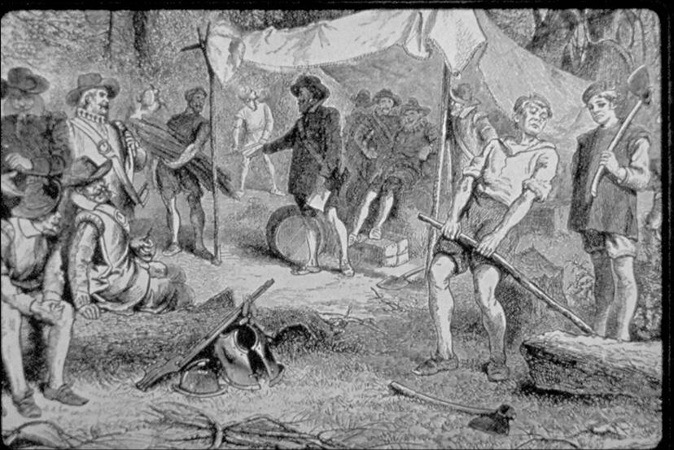
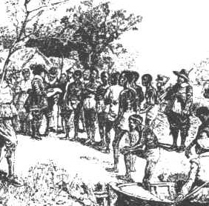
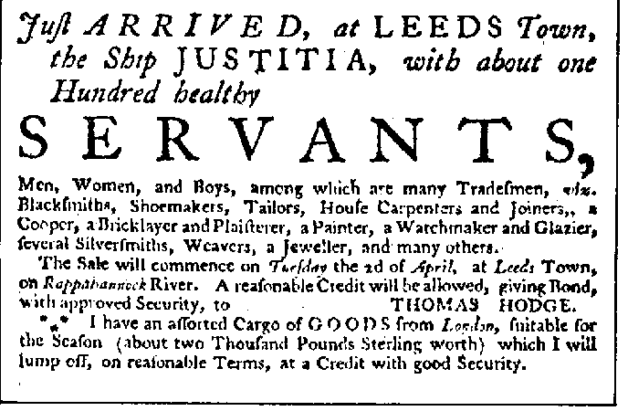
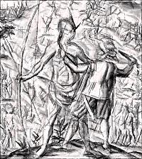
Populations
English Settlers
Native Americans
Indentured Servants
African Slaves

Slide 6
English Settlers
In order to make a profit for the Virginia Company, settlers tried a number of small industries, including ship building and glass manufacturing
In 1613, tobacco as a cash crop was introduced
Tobacco cultivation required large amounts of land and labor and stimulated the rapid growth of the Virginia colony
Settlers moved onto the lands occupied by the Powhatan Indians, and increased numbers of indentured servants came to Virginia

Slide 7
The Powhatan Confederacy
The Powhatan Confederacy helped the Jamestown colonists survive by teaching them what to grow, where to grow, and how to grow
Later, the Powhatans got mad at settlers for demanding food from the Indians and the two sides were about to go to war until...
John Rolfe married Pocohontas and learned the ways of the Indians
They taught him how to make quality tobacco that smelled and tasted good
Tobacco saved Jamestown

Slide 8
Indentured Servants
Colonists faced a very difficult life to include high death rates and labor shortages
To fill this need for labor, indentured servitude was created
Indentured servants were colonists that signed a contract for a period of 4-7 years of service in return for passage to the new world.

Slide 9
African Slaves
The first documented Africans in Virginia arrived in 1619
They were from West Central Africa and had been captured during war with the Portuguese
The first Africans may have been treated as indentured servants
The practice of owning Africans as slaves for life appeared by mid-century
The number of African slaves increased significantly in the second half of the 17th century, replacing indentured servants as the primary source of labor

Slide 10
Government
THE HOUSE OF BURGESSES
The Virginia House of Burgesses was the first elected legislative body in America giving settlers the opportunity to control their own government
The first assembly met on July 30, 1619 in the church at Jamestown
Present were Governor Yeardley, Council, and 22 Burgesses representing 11 plantations
Burgesses were elected representatives
Only white men who owned a specific amount of property were eligible to vote for Burgesses

Slide 11
Let’s Roll

Slide 12
Let’s Write

Slide 13
Let’s Assess

Slide 15
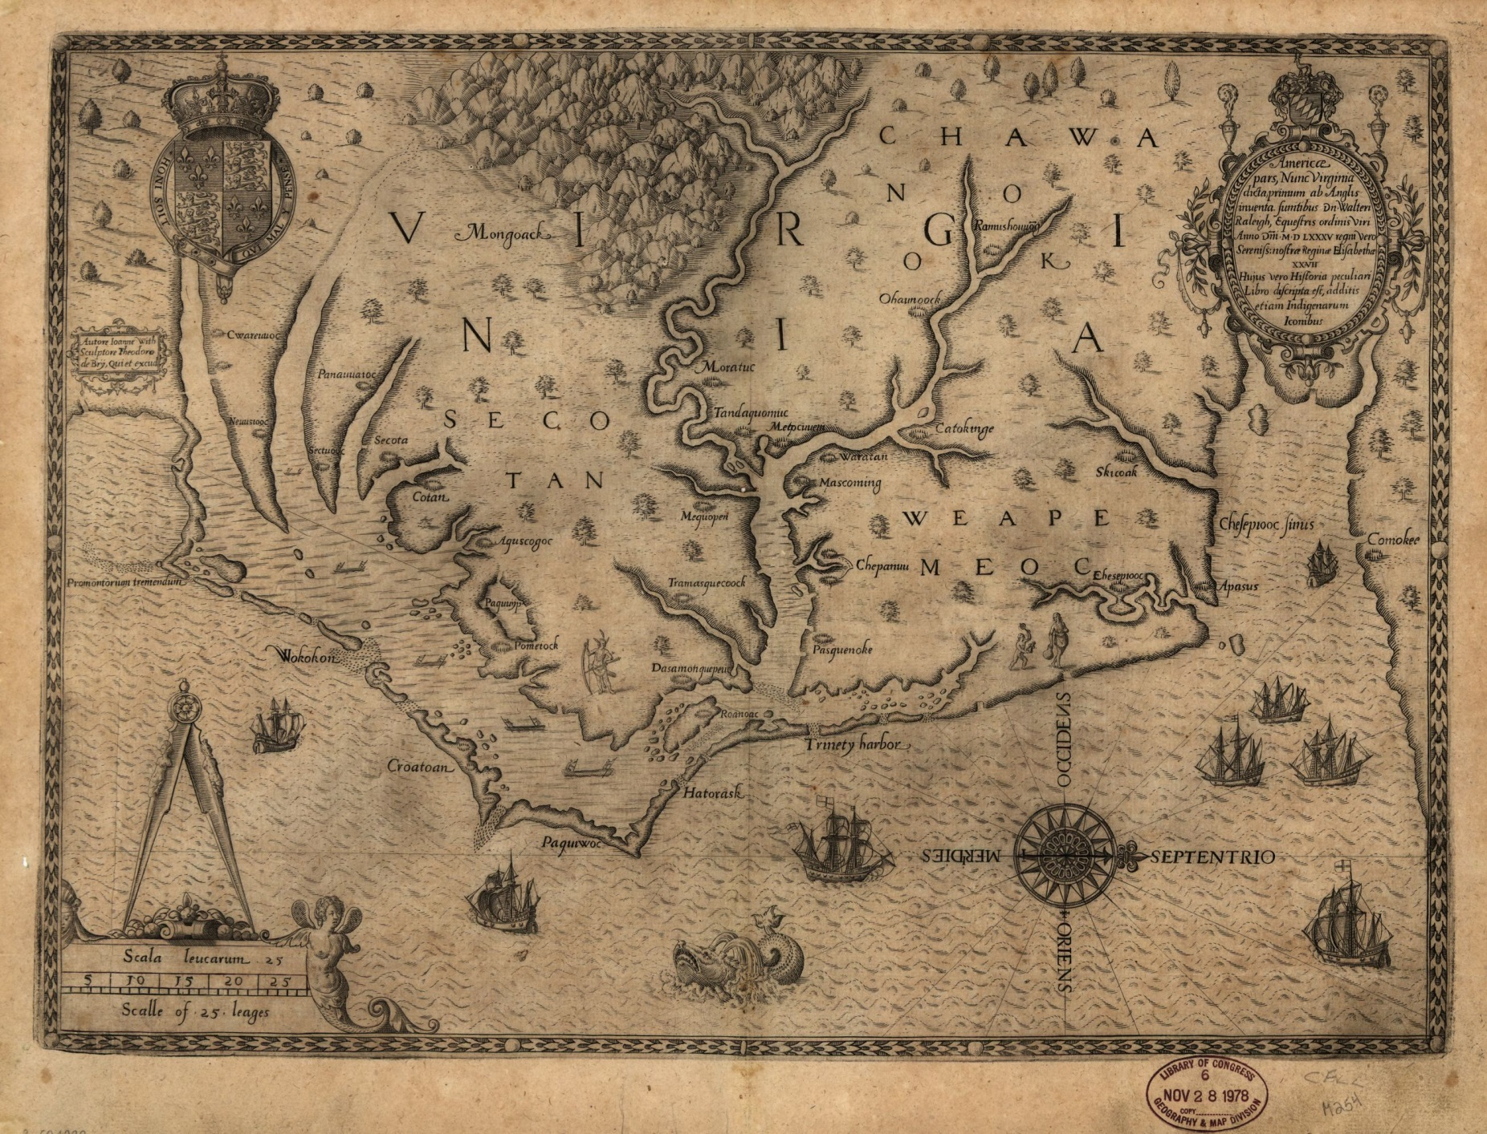

Slide 16
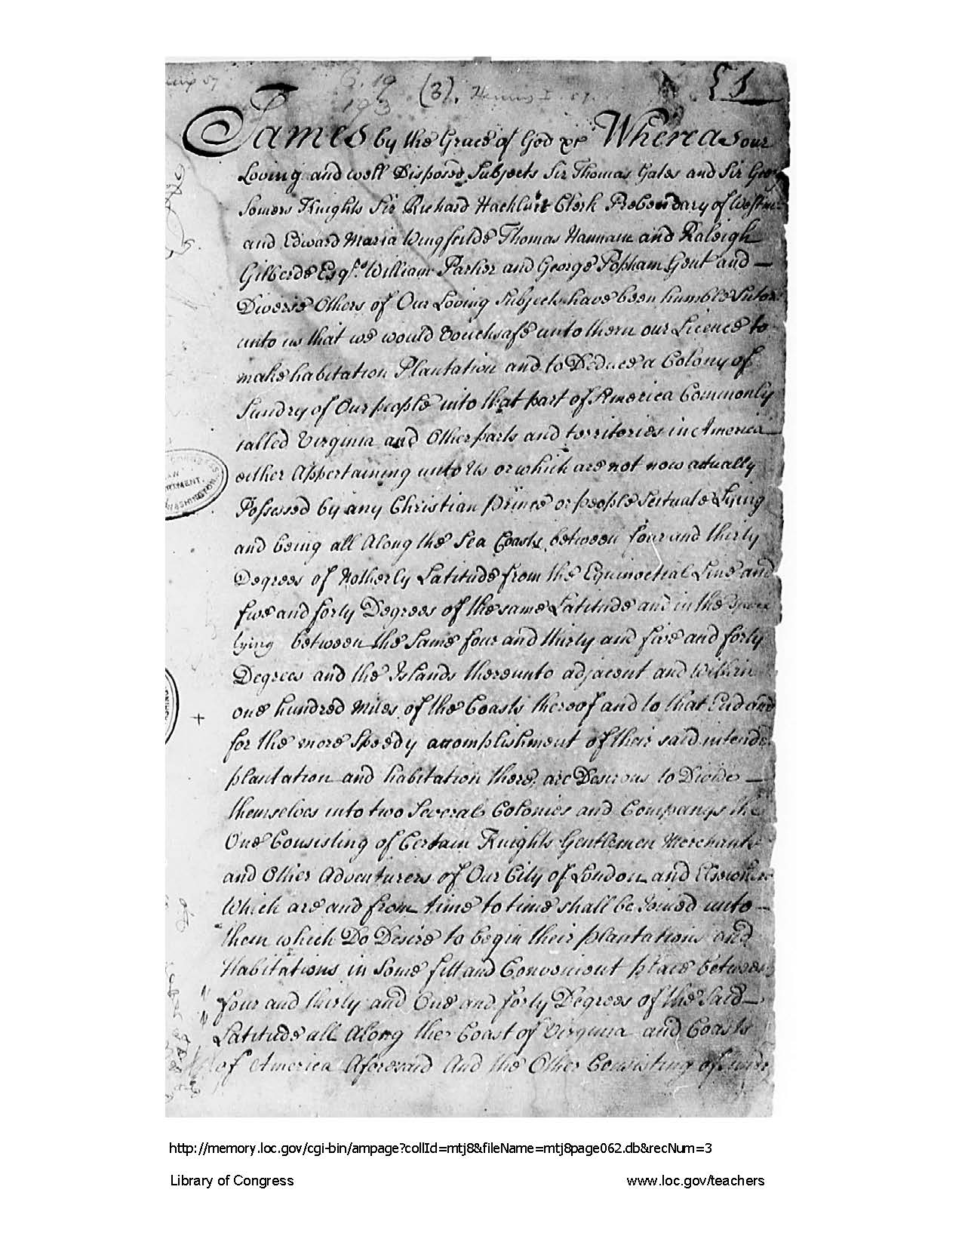

Slide 17
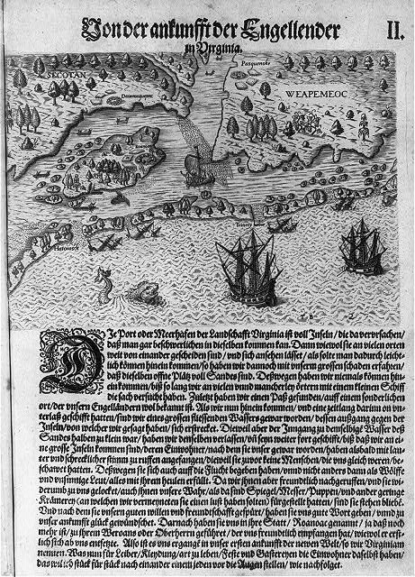

Slide 18
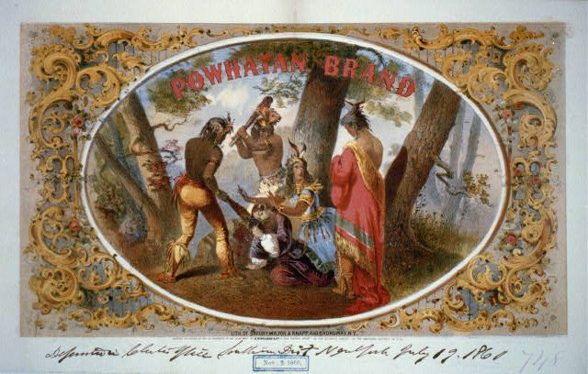

Slide 19
Bibliography
http://www.loc.gov/teachers/classroommaterials/primarysourcesets/jamestown/
http://www.loc.gov/pictures/item/2001696963/
http://www.loc.gov/resource/g3880.ct000777/
http://memory.loc.gov/master/mss/mtj/mtj8/062/0000/0004.jpg
http://www.loc.gov/pictures/resource/cph.3b52560/
http://chnm.gmu.edu/tah-loudoun/wp-content/lessons/franklin/jamestown-settlement.jpg
http://education-portal.com/academy/lesson/powhatan-confederacy-definition-history-quiz.html
http://www.historyisfun.org/jamestown-settlement/history-jamestown/
http://www.nps.gov/jame/historyculture/african-americans-at-jamestown.htm
http://ed101.bu.edu/StudentDoc/Archives/ED101sp06/emilyo/SlaveryinJamestown.html

