Slide 1
Moral Dilemmas of the Starving time
Melanie Gouine
1.9.2016

Slide 2
What would you do?
Check out the scenarios on your paper strip. Share the first scenario. Discuss with your partner what you would choose to do in this scenario. Your partner will then share their choice. Move on to another scenario when you are ready.

Slide 3
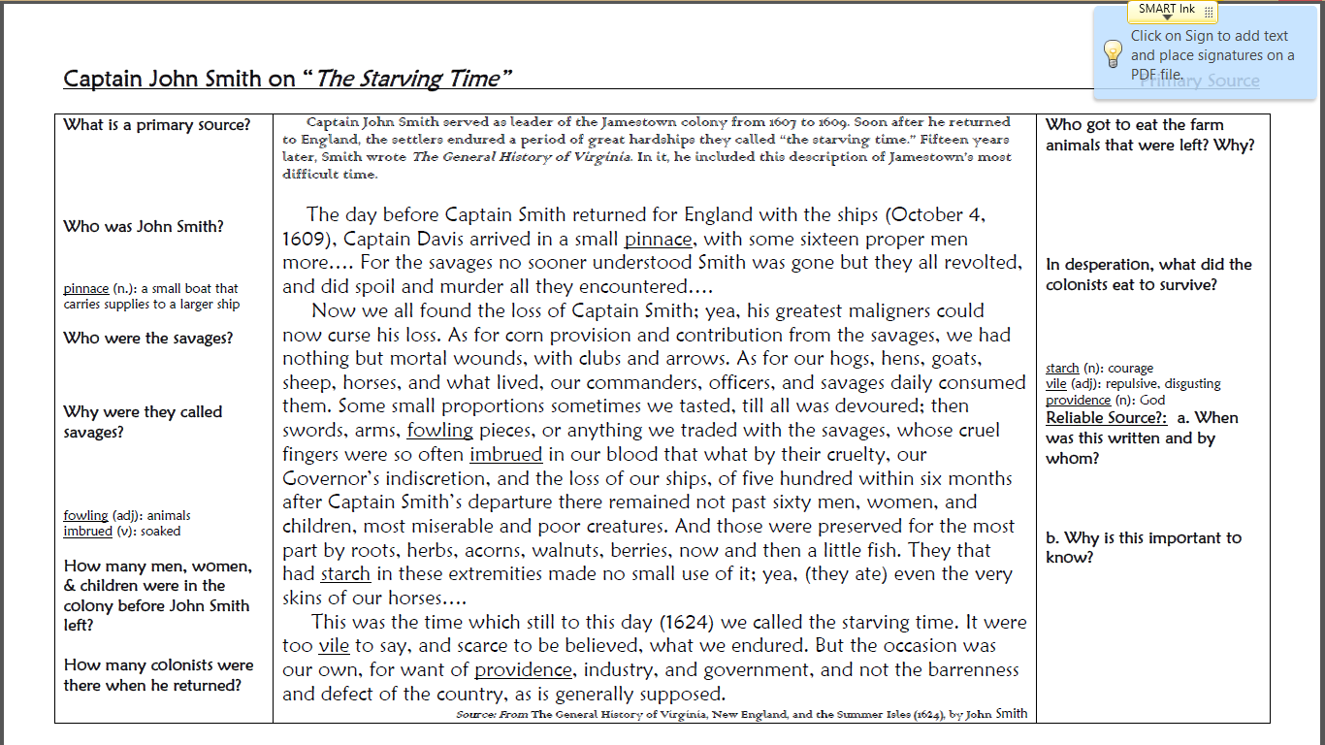
Captain John Smith’s Diary Entry

Slide 4
Cultural Approach
Using the diary entry, think about the categories of the Cultural Approach. Can you pull out any categories from the writing?
Maybe you can pull out a category that is IMPLIED but not directly stated.
Maybe you can pull out a category from information you have learned about this event that may not be included in the diary entry.
For example, “I chose social because the colonists had a very difficult relationship with the Powhatan Indians. They were so afraid to leave the camp for fear of being killed.”

Slide 5
If I were a colonist during the starving time
I want you to brainstorm what you would do if you were a colonist during the Starving Time. Make a web that creates a plan for a survival.
Once you have a brainstormed list, turn and talk with a partner about what you came up with.

Slide 6
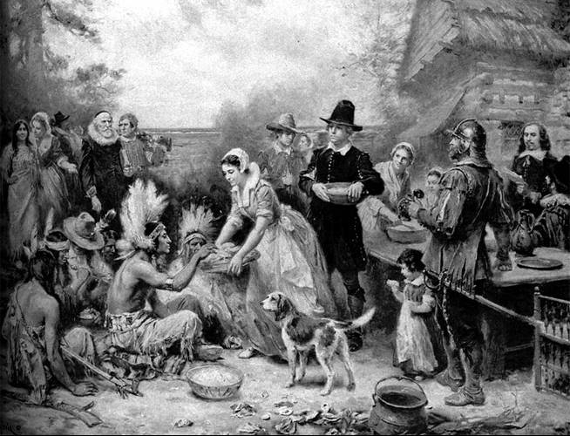
Source #1
Take a look at the picture.
What do you see?
Make only observations of the photograph on your handout.
Now, use those observations to make some inferences about what you think is going on in the photo and how it is related to the Starving Time.

Slide 7
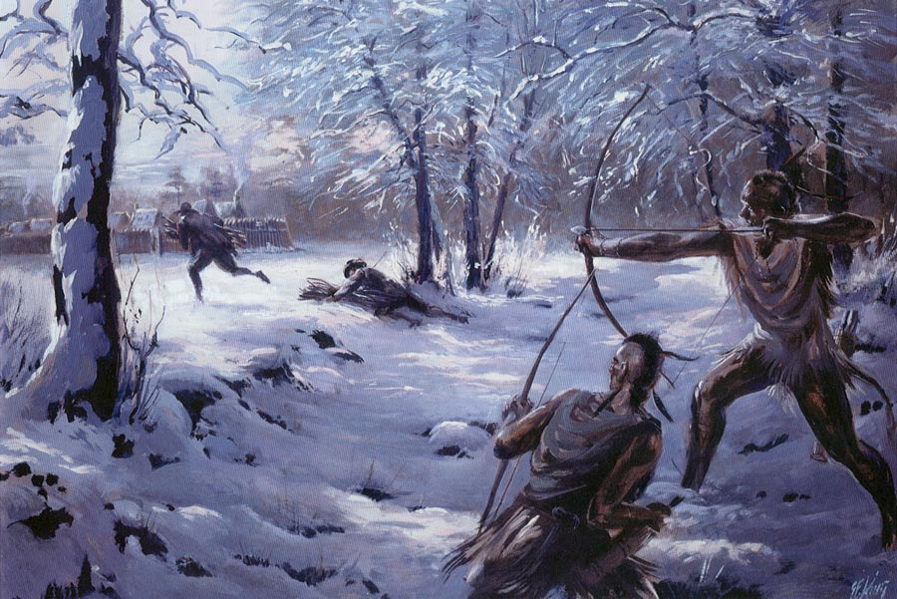
Source #2
Take a look at the picture.
What do you see?
Make only observations of the photograph on your handout.
Now, use those observations to make some inferences about what you think is going on in the photo and how it is related to the Starving Time.

Slide 8
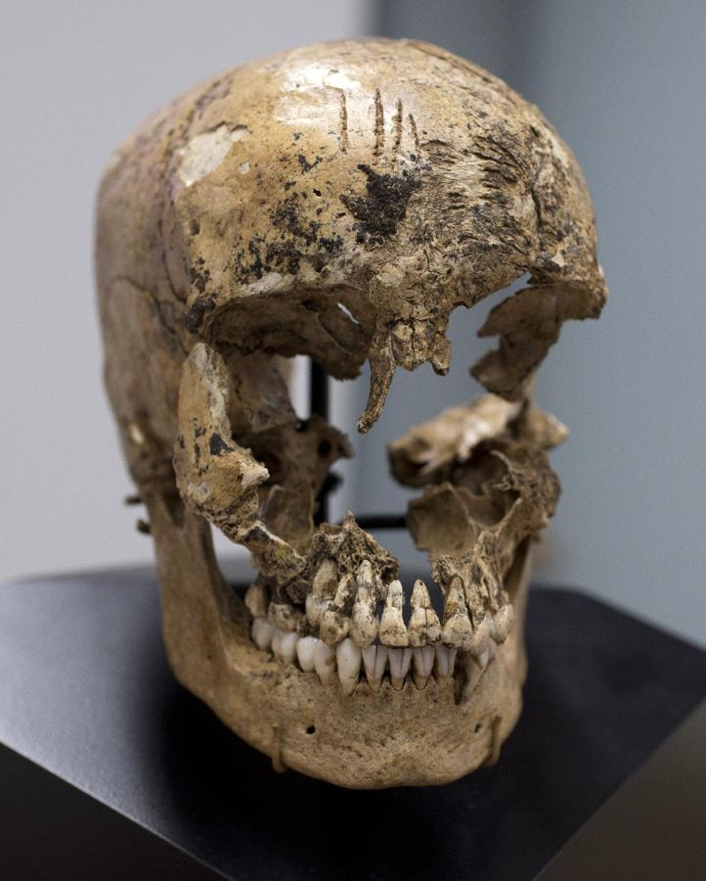
WASHINGTON -- Jamestown's colonists resorted to cannibalism during the "starving time" winter of 1609-10, archaeologists confirmed Wednesday.
In a briefing at the Smithsonian's National Museum of Natural History, archaeologist Doug Owsley presented the reconstructed skull of a 14-year-old English girl, named "Jane" by the researchers, discovered at the site of the fort and bearing the marks of butchery.
"The skull was split in half, most likely with a lightweight ax or quite possibly, a cleaver," Owsley said at the briefing. Cut marks crisscrossing the skull and jaw of the girl indicate her flesh, tongue and brains were removed from the skull, Owsley said. Those were traditional cuts for animal butchery of the time, "all parts of the cuisine of the 17th century," he said.
Source #3
Read the article.
Make only observations of the article on your handout.
Now, use those observations to make some inferences about what you think is going on in the article and how it is related to the Starving Time.

Slide 9
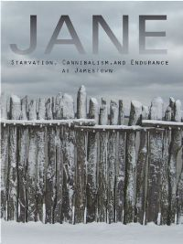

Slide 10
OPTIONAL: Living history - jane
Teacher will put on a living history as Jane. The teacher can have another adult come in and ask interview questions if needed. The students can then have a chance to ask questions as well.

Slide 11
When Survivor was more than a game
You will work in groups to play a game which will require you to place yourselves into the shoes of the colonists during the Starving Time. The game board will have winding roads that will lead you through all types of obstacles. You will be forced to make very difficult decisions. Many will find their fate to be extremely dismal with very few finding survival. Get into groups of 2-5. The goal of the game is to try and make it through the Starving Time alive. Whoever makes it to the finish line first, is the winner. The other players still on the board did not make it through the Starving Time alive.

Slide 12
Debate Time!
As your assessment, you will be required to choose a position on either side of a very difficult moral dilemma. These dilemmas are true to what the colonists faced. You will formulate your position based on facts and opinions on how you believe the colonists should have responded to these difficult choices during the Starving Time.
We will create a rubric together and it will be used to assess your understanding and performance.

